Slide 1
Nordic Blockchain
Luca Francioni - 240068

Slide 2
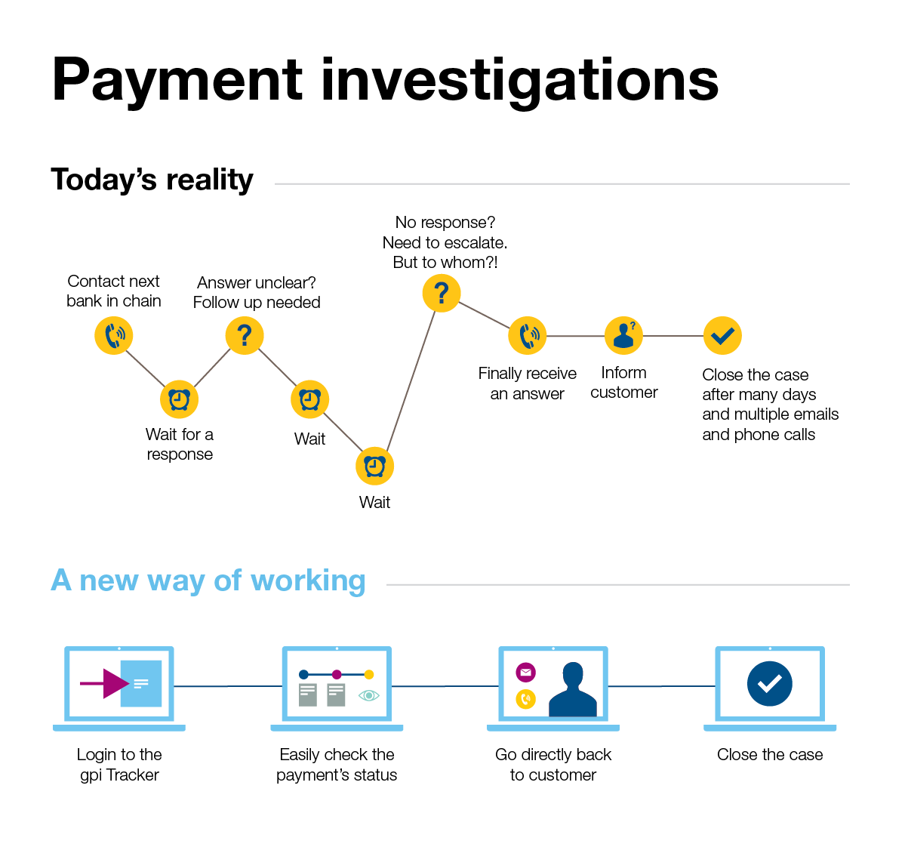
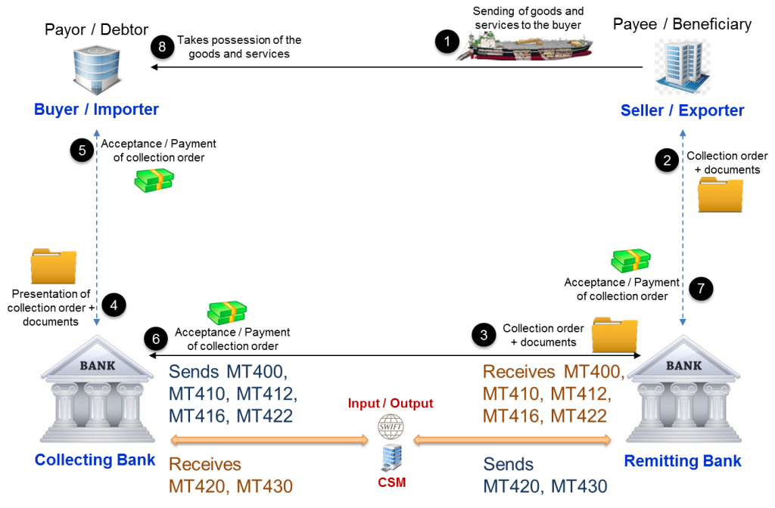
SWIFT CSM

Slide 3
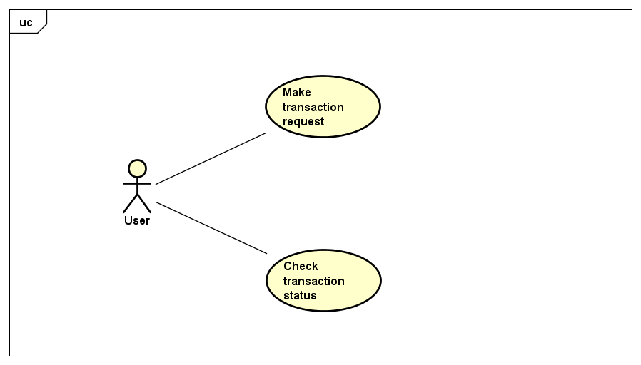
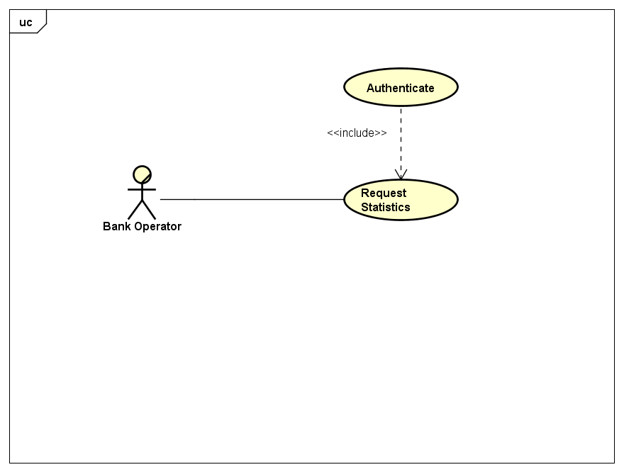
What is that a bank wants from this system?

Slide 4
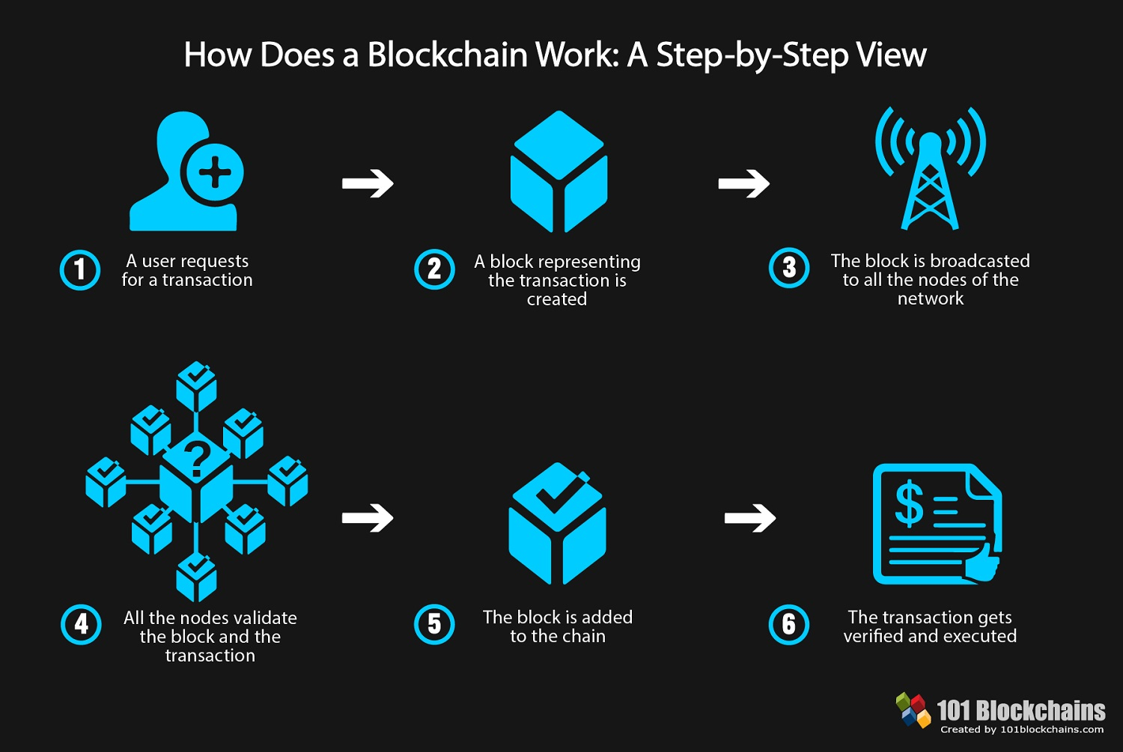
Is a Blockchain a suitable technology?

Slide 5
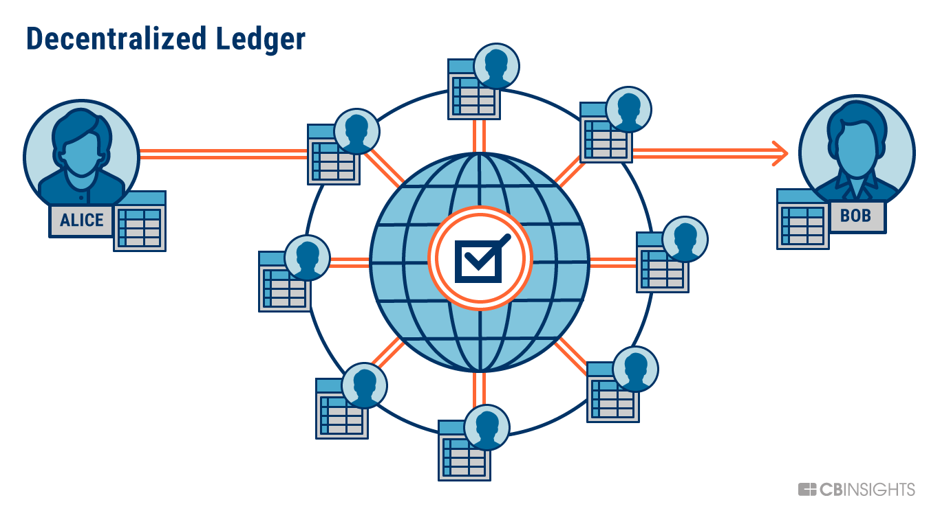
The Ledger

Slide 6
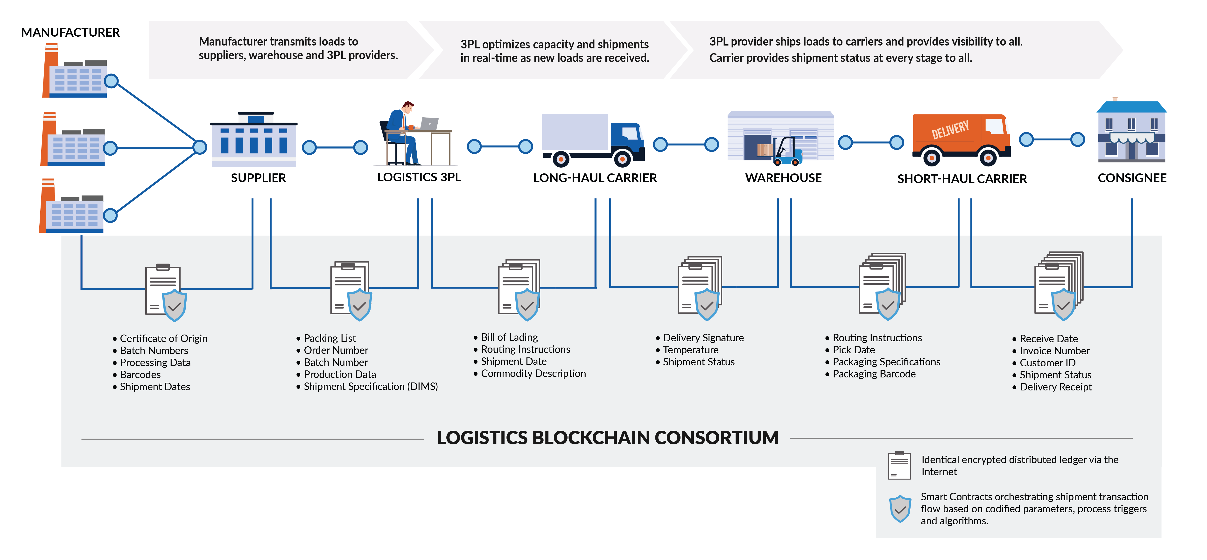
Where are BCs already used?

Slide 7
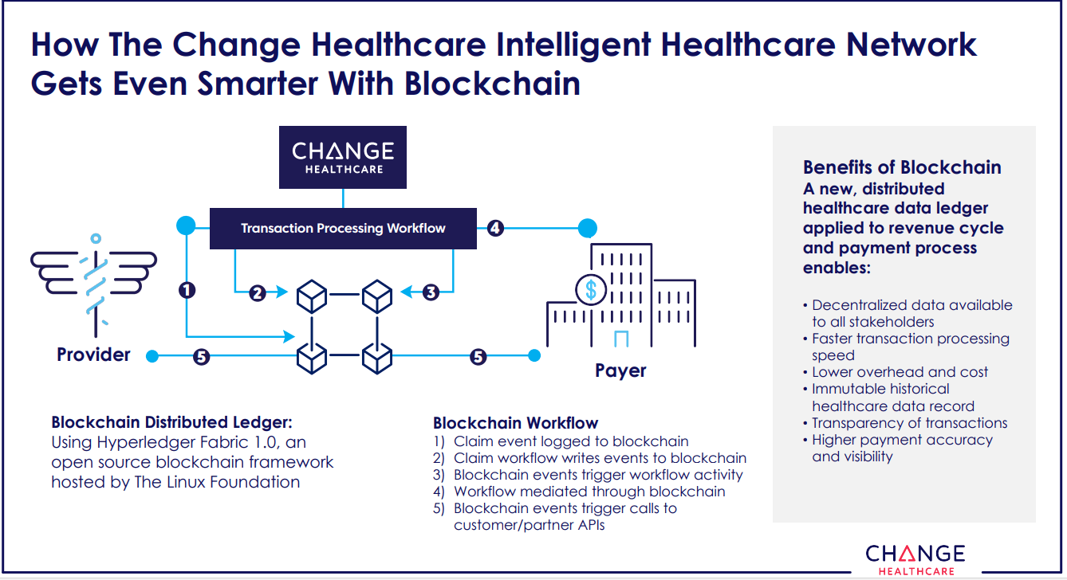
Even healthcare

Slide 8
Advantages & Constraints
Transparency – The entire network (the banks) can see transactions in real-time.
Speed – The more miners, the faster the queue elaboration (in NB).
Security – Blockchain’s security standards offer great protection from tampering.
Integration – Integrating such technology wouldn’t be that hard if designed with modularity in mind.
Sacrificing privacy, partially…
Requires further research and testing.
Energy consumption? Let’s see…

Slide 9
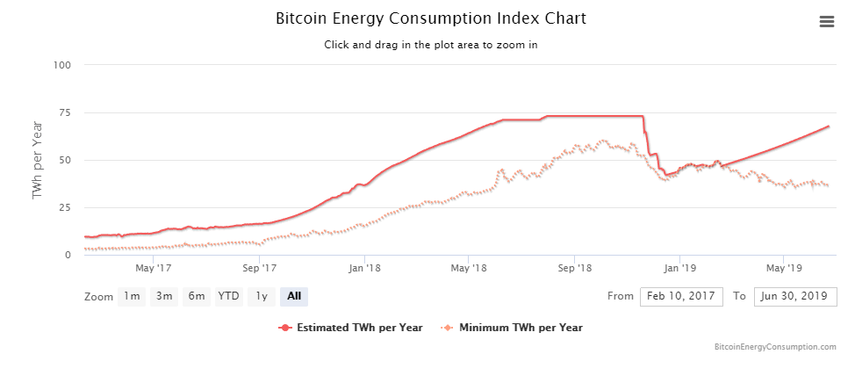
A problem with cryptocurrency’s blockchain usage

Slide 10
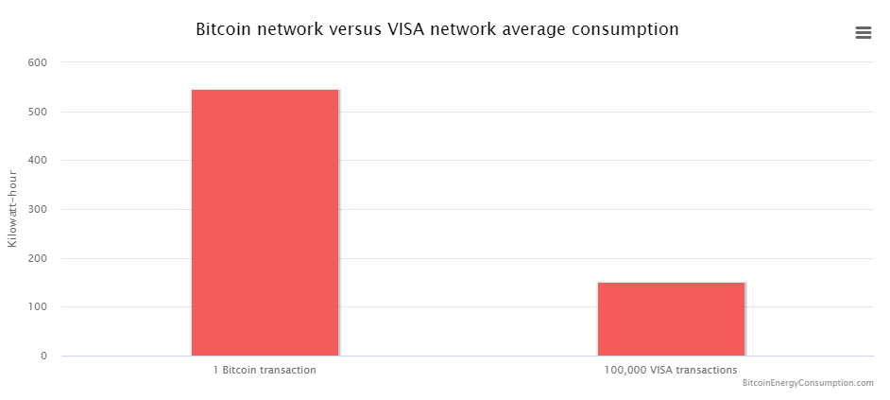
A problem with cryptocurrency’s blockchain usage

Slide 11
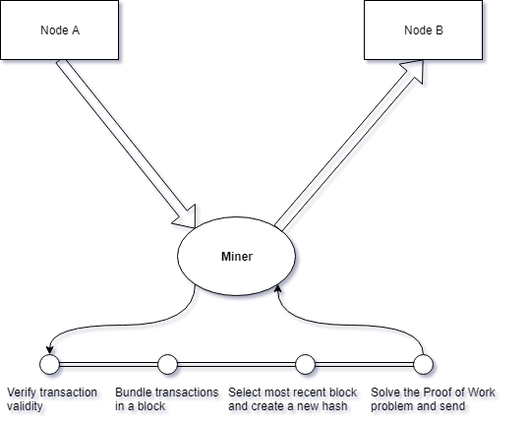
Where in the flow does this happen? (BTc)

Slide 12
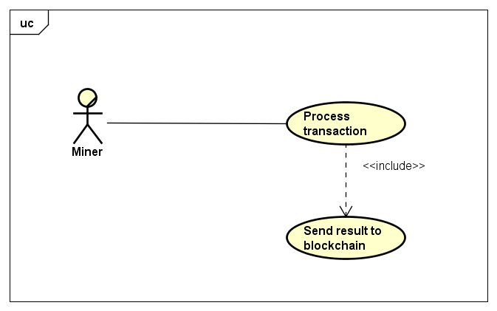
The miner

Slide 13
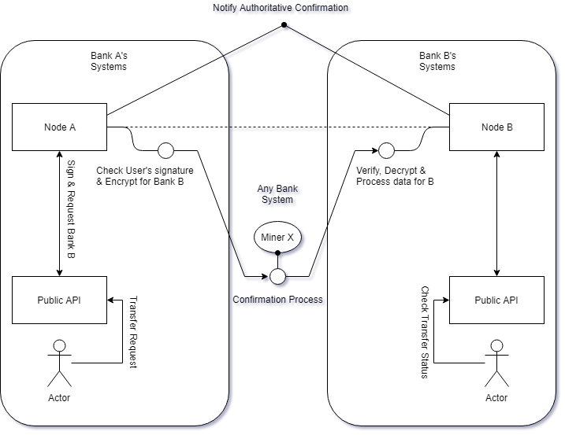
Nordic Blockchain

Slide 14
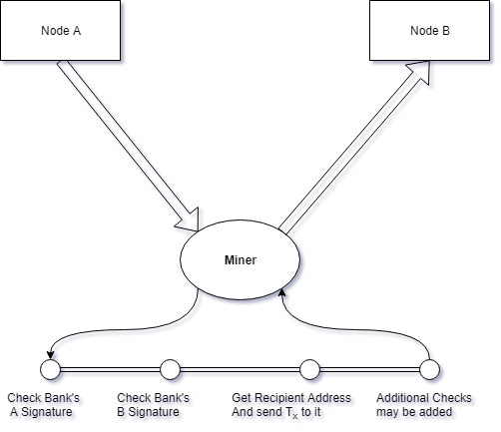
Redesigned miner model in Nordic Blockchain

Slide 15
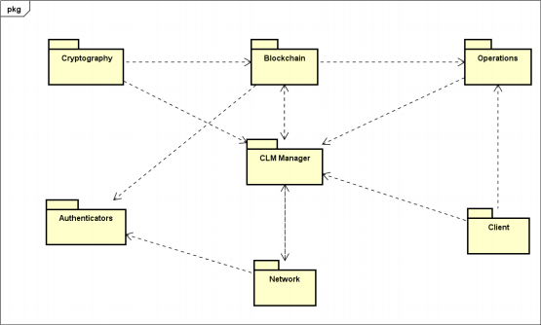
Overall Structure
What we need:
A networking system for communications
The blockchain
A hashing algorithm for tampering detection
Authentications

Slide 16
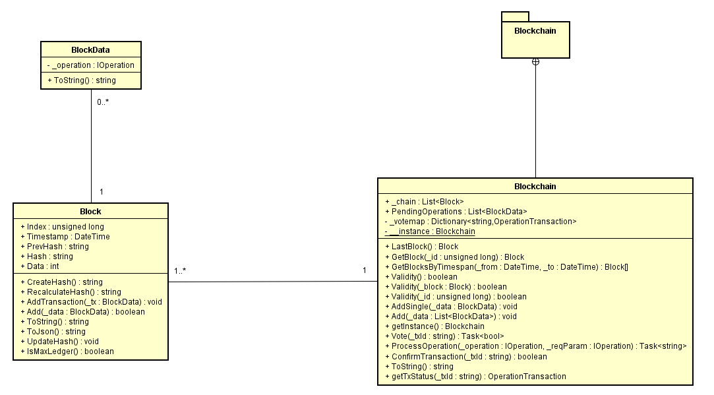
Start with the base: Blockchain

Slide 17
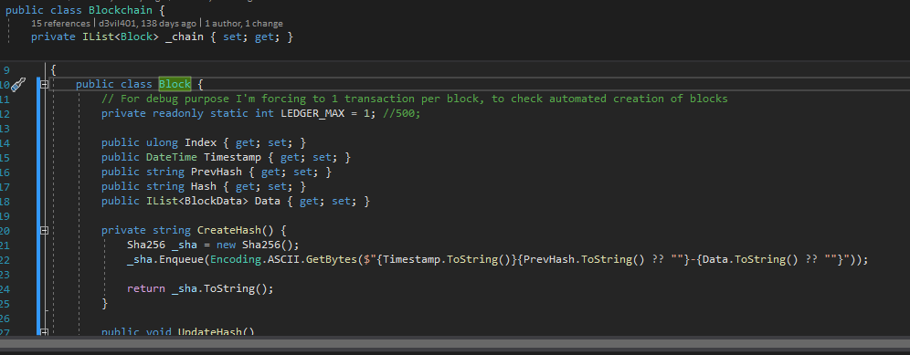

The basic structure

Slide 18
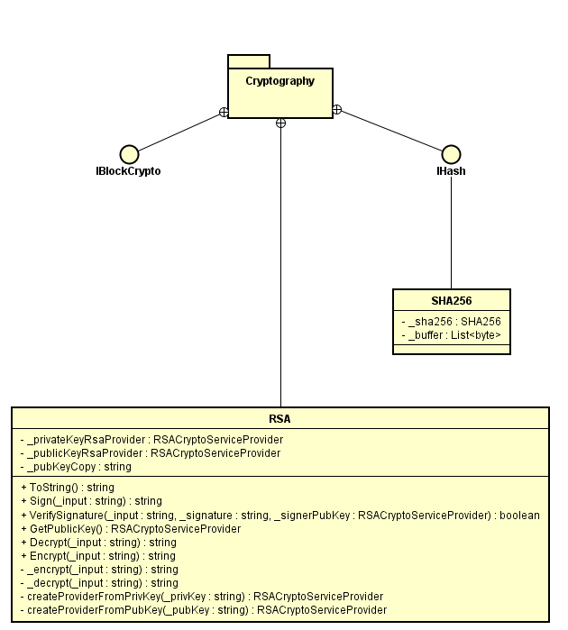
Crypto

Slide 19
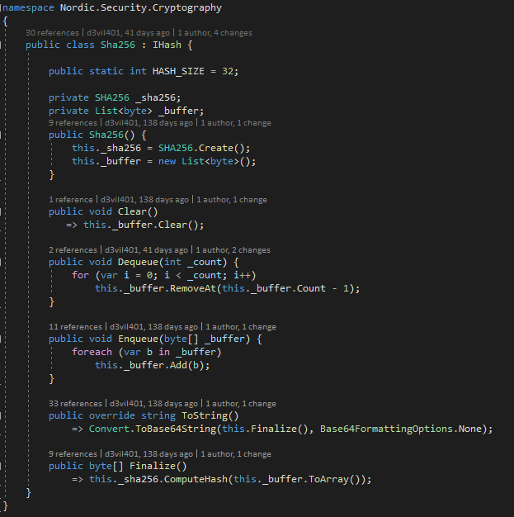
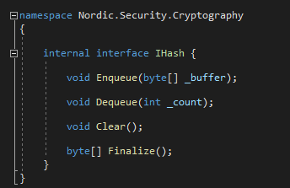
Hashing

Slide 20
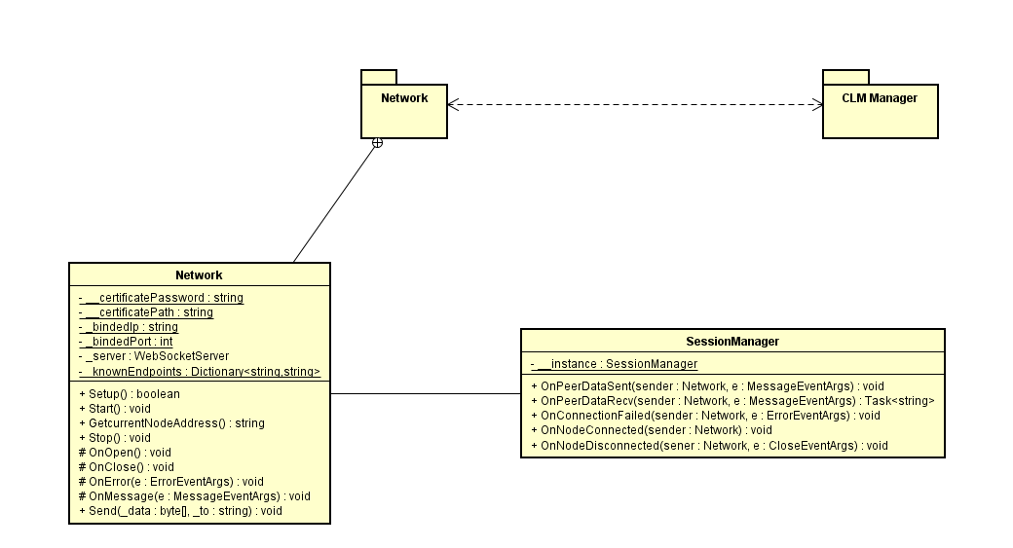
Networking

Slide 21
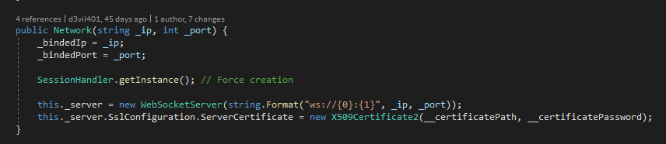
Networking: Socketing

Slide 22
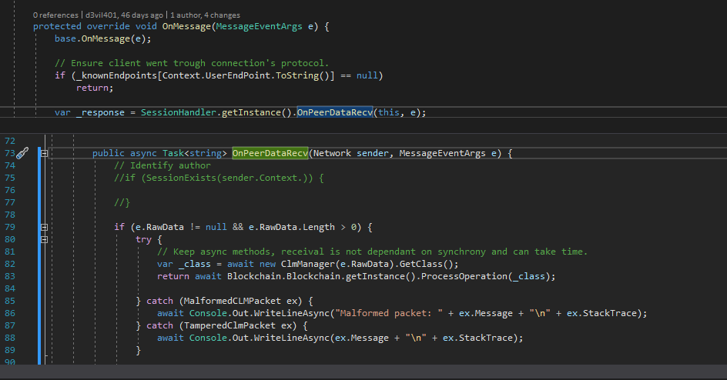
Networking: Handling messages

Slide 23
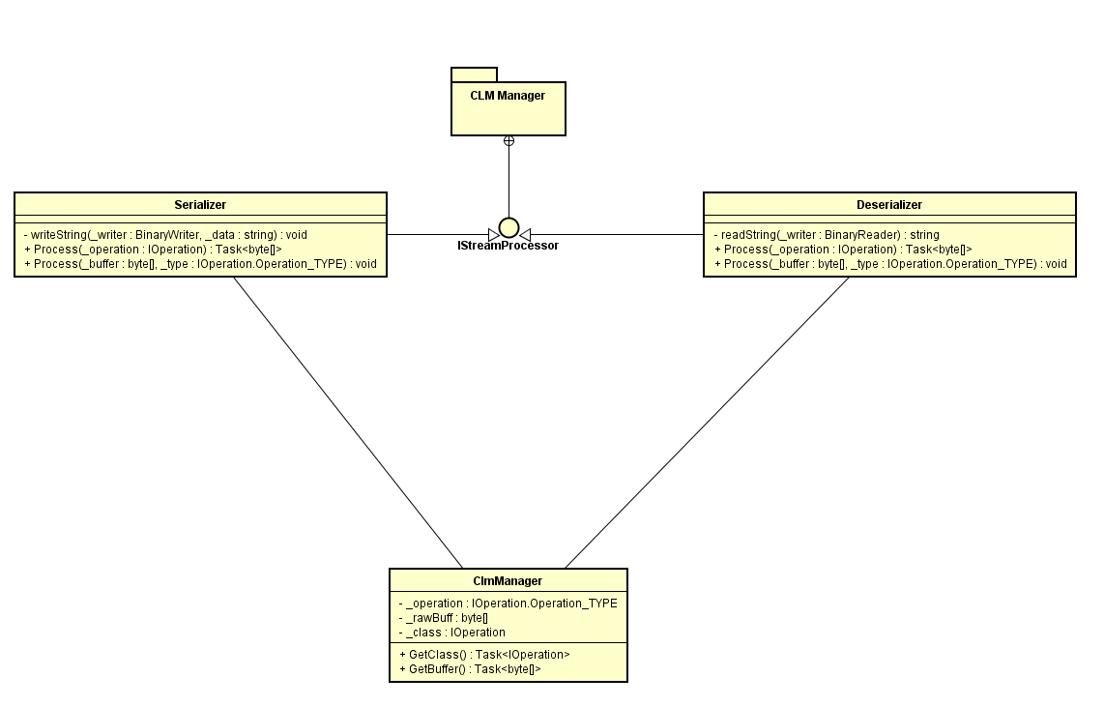
Networking: Serialization & Deserialization

Slide 24
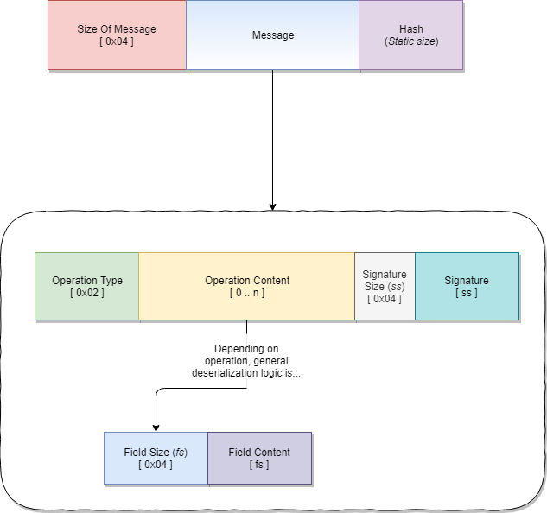

Slide 25
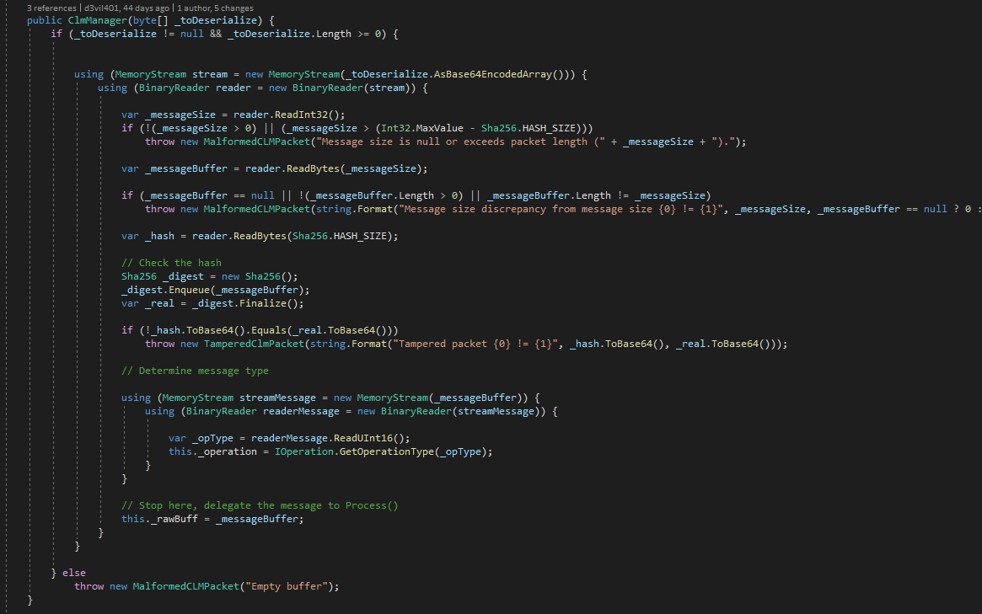
Networking: Serialization & Deserialization

Slide 26
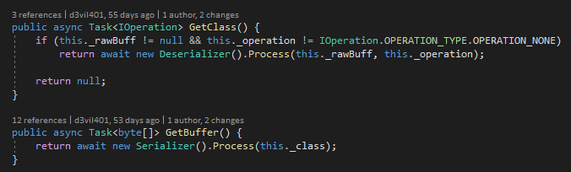
Networking: Serialization & Deserialization

Slide 27
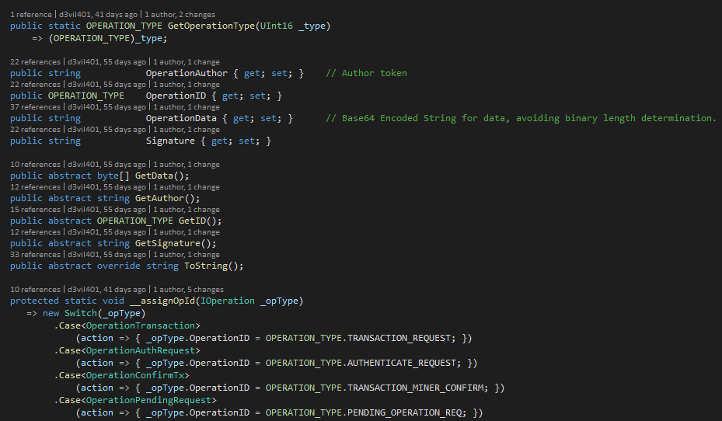
Networking: IOperations

Slide 28
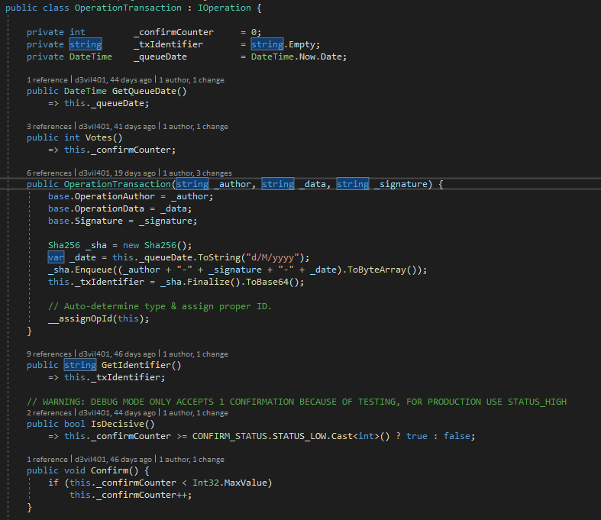
Example: OperationTransaction

Slide 29
Run it!

Slide 30
Testing the project
Unit Tests:
Testing the blockchain’s functionalities and structure, including components.
Testing the cryptographic components.
Test the network, both server and client and the components for protocol handling.
Test the Node trough a dedicated project Test the Miner trough a dedicated project

Slide 31
Results
The project does satisfy the requirements from the bank:
We can make transactions.
We can check the node’s status.
The miner can fetch and confirm transactions (or refuse them).
The blockchain does work and does respect the internal security protocol.
The blockchain does create the genesis block.

Slide 32
Results: there are still problems
The authenticators don’t work properly and are not adopted: ServerAuthenticator does not work.
I did not encrypt the CLM packets.
There should be a better transaction identifier input basis.
The dedicated projects for testing should be removed and migrate the logic into the unit testing framework.
Transaction requests should be partially improved.
There is no wallet system/user identification system!
No node synchronization & communication, IBroadcast is the only trace of attempted implementation.
SessionHandler is not properly implemented.

Slide 33
References
Jean Paul, 6 December 2018. “Collecting Bank and Remitting Bank in SWIFT Category 4 Messages” https://www.paiementor.com/collecting-bank-and-remitting-bank-in-swift-category-4-messages/ [Accessed 23/06/2019] SWIFT, 26 September 2018. “Closing the case on payment investigations” https://www.swift.com/news-events/news/closing-the-case-on-payment-investigations [Accessed 23/06/2019]
Digiconomist, 2019. “Bitcoin Energy Consumption Index” https://digiconomist.net/bitcoin-energy-consumption [Accessed 23/06/2019]

